Slide 1
Diversity and Inclusion test
Round 2 of interview for Tarak Shah by Will N.

Slide 2
Studying the diversity
Diversity and inclusion is a company’s mission, strategies, and practices to support a diverse workplace and leverage the effects of diversity to achieve a competitive business advantage.

Slide 3
Gender Equality
Our study suggests that there are almost equal number of male (4966) and female (4856) employees in the company.
Look at the bar chart to understand more.

Slide 4
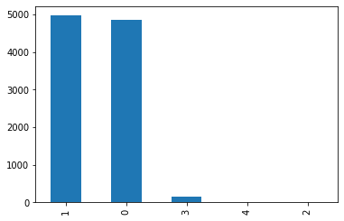
Index
1 = MALE
0 = FEMALE
3 = PN
4 = SI
2 = NB

Slide 5
Ethnicity
A company should be rich in it’s ethnicity and our study for this organization reveals the company has ex cellent ethnic diversity.
If you see the pie chart given in the next slide, you’ll understand that there are 5 ethnic groups working in the company with an almost equal weightage to each ethnicity.

Slide 6
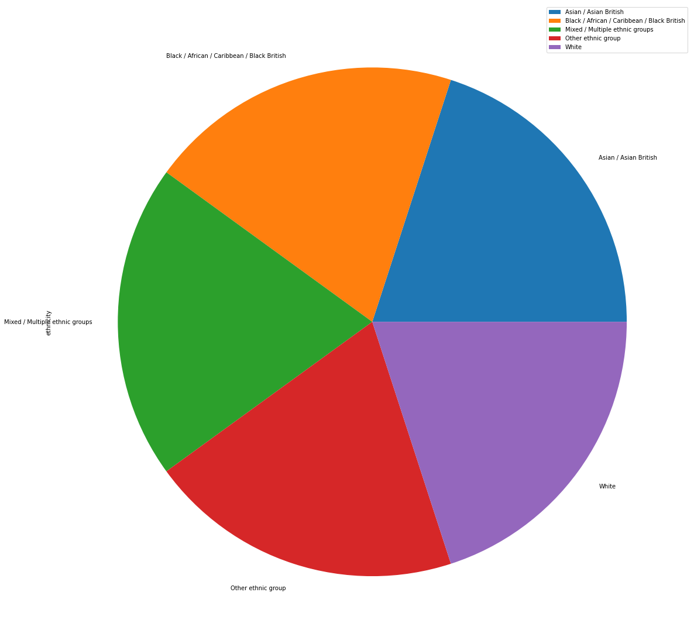

Slide 7
Mean Salary
The average salary of the employees’ is 35.75 units with a minimum of 3.0 and maximum of 547.0
This shows that the company has wide salary gap between high earning and low earning groups

Slide 8
Education diversity
Studying the education data suggests that the company has a lot of employees (67.02 %) without any degree followed by people with an undergrad degree(31.87).
People with PhD and Postgrad account for a mere 1.11 % of the company.

Slide 9
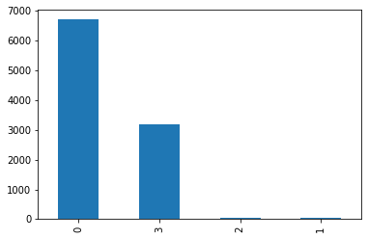
Education Index:
0 : No degree
1: PhD
2: Postgrad
3: Undergrad

